Slide 1

DePause
Student name: Student ID:
Notes:
What is the most significant change you have made that has made the most impact? The Passport
Major impact, monumental change.. More planning involved.
Is there a particular student you can see has made a major improvement from your help

Slide 2
Outline
Project overview
Requirement specification migration
Use case design
Technical specifications
Gantt Chart analysis
Challenges encountered
Conclusions and future work

Slide 3
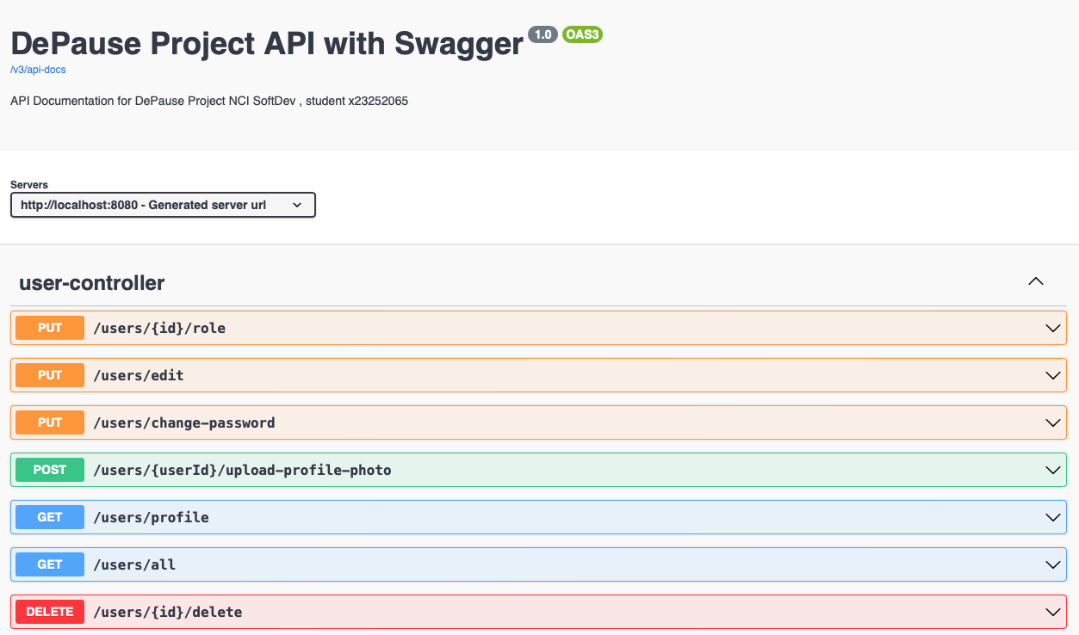
Requirement specification migration

Slide 4
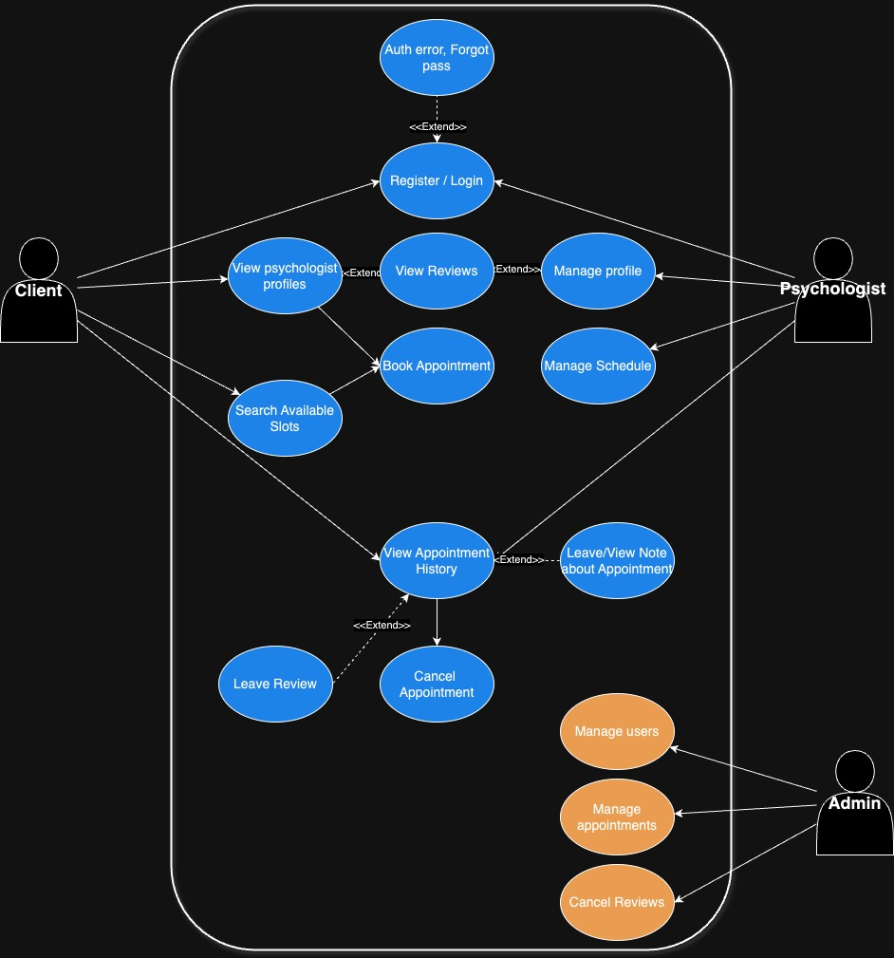
Use case design

Slide 5

Technical specifications

Slide 6
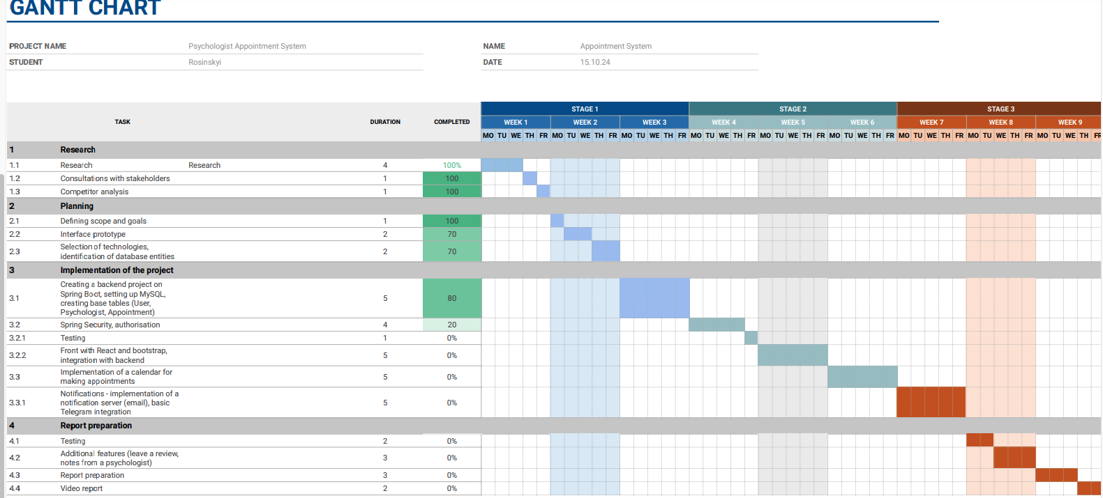

Gantt Chart analysis
When I was planning it, it seemed to me that everything was going according to plan

Slide 7

Challenges encountered
Dependencies,
React,
Refactoring,
Dreaming

Slide 8

Conclusions and future work
Plan to rework some backend logic and fully integrate the remaining endpoints into the frontend. Additionally, I aim to implement messaging integrations with WhatsApp and Telegram to improve communication between psychologists and clients

Slide 9
References
https://www.linkedin.com/in/nomany/

